Slide 1
Biological Impact of Adverse Childhood Experiences (ACES), Toxic Stress and Resilience
Robert Shapiro, MD & Anita Shah, DO, MPH
Mayerson Center for Safe and Healthy Children

Slide 2
Overview
The ACE Study
Toxic Stress and Neurodevelopment
Impact on learning and health
Building Resilience
Joining Forces for Children

Slide 3
The ACE Study
Notes:
Originally published in 1998

Slide 4
The ACE Study
Ongoing collaboration between Kaiser Permanente (Vincent J. Felitti, MD) and the CDC (Robert J. Anda, MD, MS)
The original ACE Study was conducted at Kaiser Permanente from 1995-1997
>17,000 HMO members from Southern California who received physical exams also completed surveys regarding their childhood experiences and current health status and behaviors
CDC continues ongoing surveillance via periodic updates of morbidity and mortality
Source: CDC. https://www.cdc.gov/violenceprevention/acestudy/about.html

Slide 5
ACE Score Predictive of future outcomes
Adverse Childhood Experiences (First 18 Years of Life)
Abuse
Emotional abuse
Physical abuse
Sexual abuse
Neglect
Emotional neglect
Physical neglect
Household Challenges
Mother treated violently
Household substance abuse
Mental illness in household
Parental separation or divorce
Criminal household member
Source: https://www.cdc.gov/violenceprevention/acestudy/about.html
Notes:
First 18 years of life

Slide 7
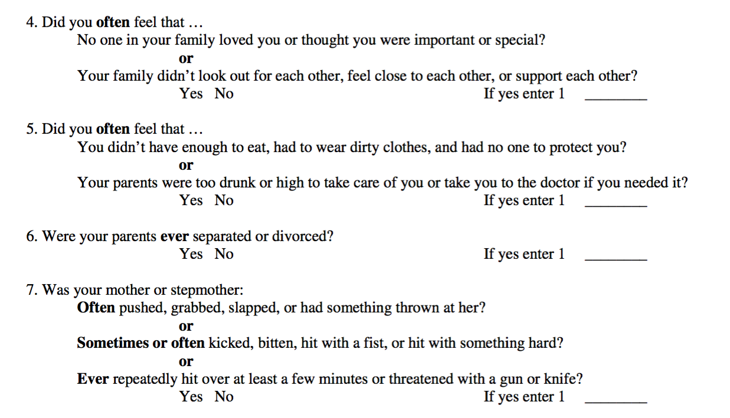

Slide 9
Cumulative ACEs and Mental Health

Slide 10
Cumulative ACEs and Chronic Disease
Notes:
In COPD, when control for negative health behaviors (like smoking) the risk is only modestly reduced.

Slide 11
ACEs and Chronic Disease
4 or more ACEs increase adjusted† odds ratio:
Ischemic heart disease - 2.2 times
Any cancer - 1.9 times
Stroke - 2.4 times
Chronic bronchitis/emphysema -3.9 times
Diabetes - 1.6 times
Hepatitis - 2.4 times
† adjusted for age, gender, race and education
Source: Felitti, Anda et al., Am J Prev Med., 1998 14(4), pp 245-258

Slide 12
The ACE Study Results
Adverse Childhood Experiences (First 18 Years of Life)
Abuse
Emotional abuse | 11%
Physical abuse | 28%
Sexual abuse | 21%
Neglect
Emotional neglect | 15%
Physical neglect | 10%
Household Challenges
Mother treated violently | 13%
Household substance abuse | 28%
Mental illness in household | 19%
Parental separation or divorce | 23%
Criminal household member | 11%
Source: https://www.cdc.gov/violenceprevention/acestudy/about.html
Notes:
First 18 years of life

Slide 13
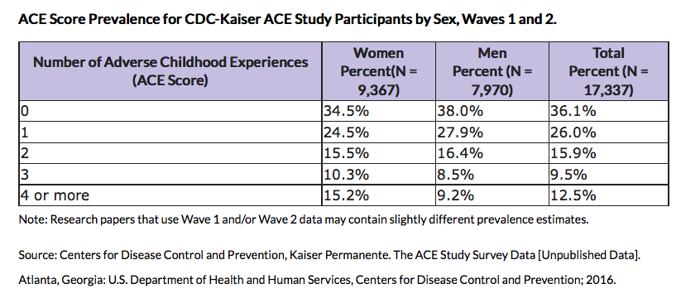
ACE Outcomes
Notes:
ACEs are common
64% have at least one ACE
12.5% have an ACE of 4 or higher

Slide 14
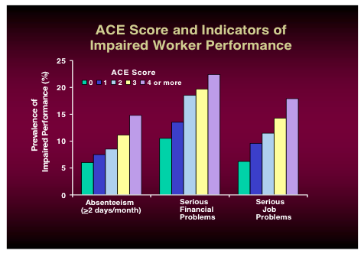
ACE Score &
Impaired Worker Performance

Slide 15
Effect of ACEs on Mortality
0 ACEs- 60% live to 65
4 ACEs- <3% live to 65
Percent in Age Group
Source: Brown, Anda et al., Am J. Prev med., 2009 37(5), pp 389-396
Notes:
The ACE Study has found that those suffering substantial childhood trauma have double the risk for early death compared with adults who had not endured adverse childhood experiences.
On average, Children exposed to 6 or more ACES died at age 60
Whereas Children without ACES died at age 79.
So – a traumatic childhood takes 20 years off an individuals life expectancy.

Slide 16
ACEs get under our skin through “Toxic Stress”
CHILD CAN LEARN TO MANAGE WITH SUPPORT OF CARING ADULT
Ex. Entering new childcare setting or getting an immunization
POTENTIAL NEGATIVE IMPACT, BUT OCCURS OVER LIMITED TIME ALLOWING FOR BRAIN RECOVERY IF BUFFERED BY SUPPORTIVE ADULT
Ex. Death of loved one, divorce
CHRONIC AND UNCONTROLLABLE, EXPERIENCED WITHOUT SUPPORT OF CARING ADULTS
Ex. Chronic abuse or neglect
Source: Center on the Developing Child at Harvard University
Notes:
A brief review of what was covered in the module and brain architecture game

Slide 17
The Stress Response
Stress responses lead to activation of hormone and neurochemical systems throughout the body
1. Sympathetic-Adrenomedullary System
Adrenaline is produced and helps to mobilize energy stores and alter blood flow
2. Hypothalamic-Pituitary-Adrenocortical System
Cortisol is released and mobilizes energy stores, enhances certain types of memory and activates immune responses
National Scientific Council on the Developing Child. (2005/2014). Excessive Stress Disrupts the Architecture of the Developing Brain: Working Paper 3. Updated Edition. http//www.developingchild.Harvard.edu
Notes:
These occur under normal circumstances and help prepare the body for coping with stressors.
These are two systems involved in stress response that have been well studied.

Slide 18
Physiologic Response to Stress
Activation of HPA & sympathetic system
Increased level of stress hormones
Transient increases = Protective
Prolonged exposure = Toxic
Notes:
Move to center (heading)

Slide 19
Notes:
Let me illustrate what toxic stress is. Imagine hiking in the woods and as you turn the corner you encounter a bear. Your heart races, your senses come alive and this helps you prepare to survive by fighting, fleeing, or freezing. Then, when the source of stress is removed, you calm yourself and your systems returns to normal. Now imagine the child who experiences these stressful situations from home, or in the neighborhood, but there is no escape or relief. This is toxic stress. It is prevalent and it is dangerous. It shapes a child to survive, not to excel. It alters the child’s brain, his DNA, and his immune system

Slide 20
Allostatic (adaptive) Systems
McEwen BS. Protective and damaging effects of stress mediators. N Engl J Med 338: 171–179, 1998.
Notes:
Inactivation returns the systems to base-line levels of cortisol and catecholamine secretion, which normally happens when the danger is past, the infection is contained, the living environment is improved, or the speech has been given.

Slide 21
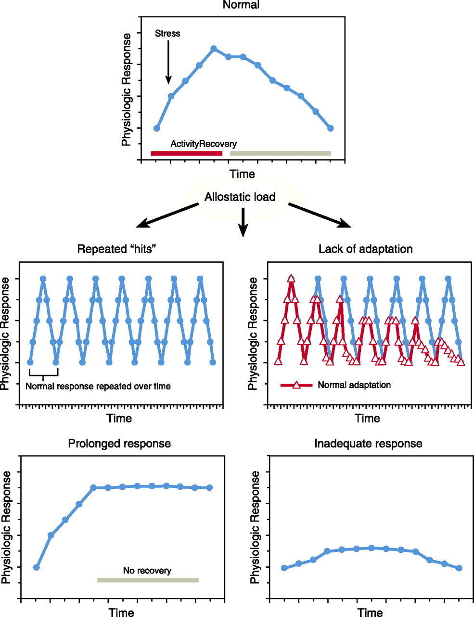
Toxic Stress
The body’s stress response changes following frequent and prolonged exposure.
May respond to lower thresholds leading to more frequent and longer periods of activation
McEwen BS. Protective and damaging effects of stress mediators. N Engl J Med 338: 171–179, 1998.
Notes:
Four situations are associated with allostatic load.
The first and most obvious is frequent stress. For example, surges in blood pressure can trigger myocardial infarction in susceptible persons
In the second type of allostatic load, adaptation to repeated stressors of the same type is lacking, resulting in prolonged exposure to stress hormones
In the third type of allostatic load there is an inability to shut off allostatic responses after a stress is terminated.
In the fourth type of allostatic load inadequate responses by some allostatic systems trigger compensatory increases in others.

Slide 22
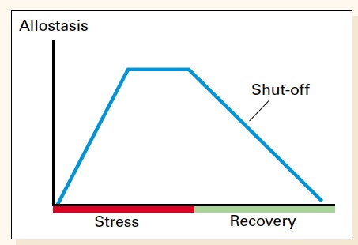
Childhood Toxic Stress
Toxic Stress is uncontrollable, unpredictable and pervasive stress.
Inactivation of stress causes an over exposure to stress hormones and creates an allostatic load.
Over weeks, months or years this can result in biologic consequences.
McEwen BS. Protective and damaging effects of stress mediators. N Engl J Med 338: 171–179, 1998.
Notes:
However, if the inactivation is inefficient there is overexposure to stress hormones. Over weeks, months, or years, exposure to increased secretion of stress hormones can result in allostatic load and its pathophysiologic consequences.

Slide 23
Cellular response to stress
McEwen BS. Protective and damaging effects of stress mediators. N Engl J Med 338: 171–179, 1998.

Slide 24
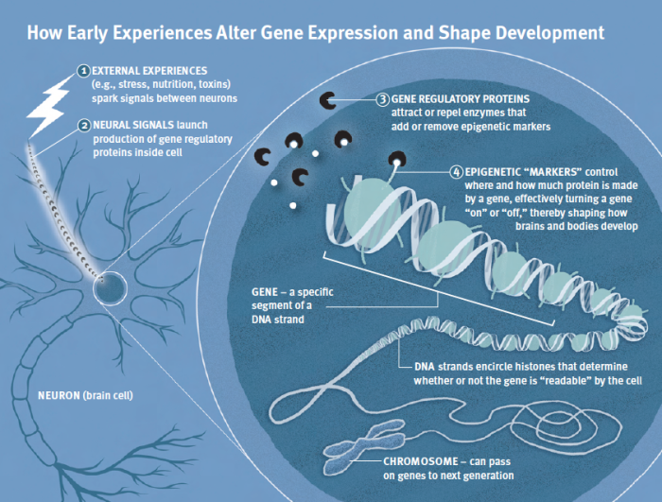
Epigenetics – Determination of Gene Expression
Source: Center on the Developing Child at Harvard University

Slide 25
Brain Changes Associated with Childhood Maltreatment
NIDA. (2015, November 19). Childhood Maltreatment Changes Cortical Network Architecture and May Raise Risk for Substance Use
Notes:
Maltreatment in childhood has been found to be associated with changes in structural connectivity at the network level
Cerebral cortex of young adults with and without childhood maltreatment
Green circles are nodal centers = regions of interest
Red circles are primary nodes = direct connections to nodal center
Blue circles are secondary nodes = direct connections with primary nodes but not nodal center
Childhood maltreatment was associated with a marked decreased in the centrality of the left anterior cingulate (indicated by a substantial decrease in primary and secondary connections).
Conversely, childhood maltreatment was associated with a significant increase in the centrality of the right anterior insula and the right precuneus (indicated by greater number of primary and secondary nodal connections)

Slide 27
Toxic Stress and its Impact on Neurodevelopment
In extreme cases (ex. severe chronic abuse), especially during early sensitive periods of brain development:
Regions of the brain involved in fear, anxiety and impulsive responses may overproduce neural connections
Regions dedicated to reasoning, planning and behavioral control may produce fewer connections
National Scientific Council on the Developing Child. (2005/2014). Excessive Stress Disrupts the Architecture of the Developing Brain: Working Paper 3. Updated Edition. http//www.developingchild.Harvard.edu

Slide 28
Brain Changes Associated with Childhood Maltreatment
Unexposed
Maltreated
Teicher, Martin H., et al. "The effects of childhood maltreatment on brain structure, function and connectivity." Nature Reviews Neuroscience 17.10 (2016): 652-666.
Notes:
Maltreatment in childhood has been found to be associated with changes in structural connectivity at the network level
Cerebral cortex of young adults with and without childhood maltreatment
Green circles are nodal centers = regions of interest
Red circles are primary nodes = direct connections to nodal center
Blue circles are secondary nodes = direct connections with primary nodes but not nodal center
Childhood maltreatment was associated with a marked decreased in the centrality of the left anterior cingulate (indicated by a substantial decrease in primary and secondary connections).
Conversely, childhood maltreatment was associated with a significant increase in the centrality of the right anterior insula and the right precuneus (indicated by greater number of primary and secondary nodal connections)

Slide 29
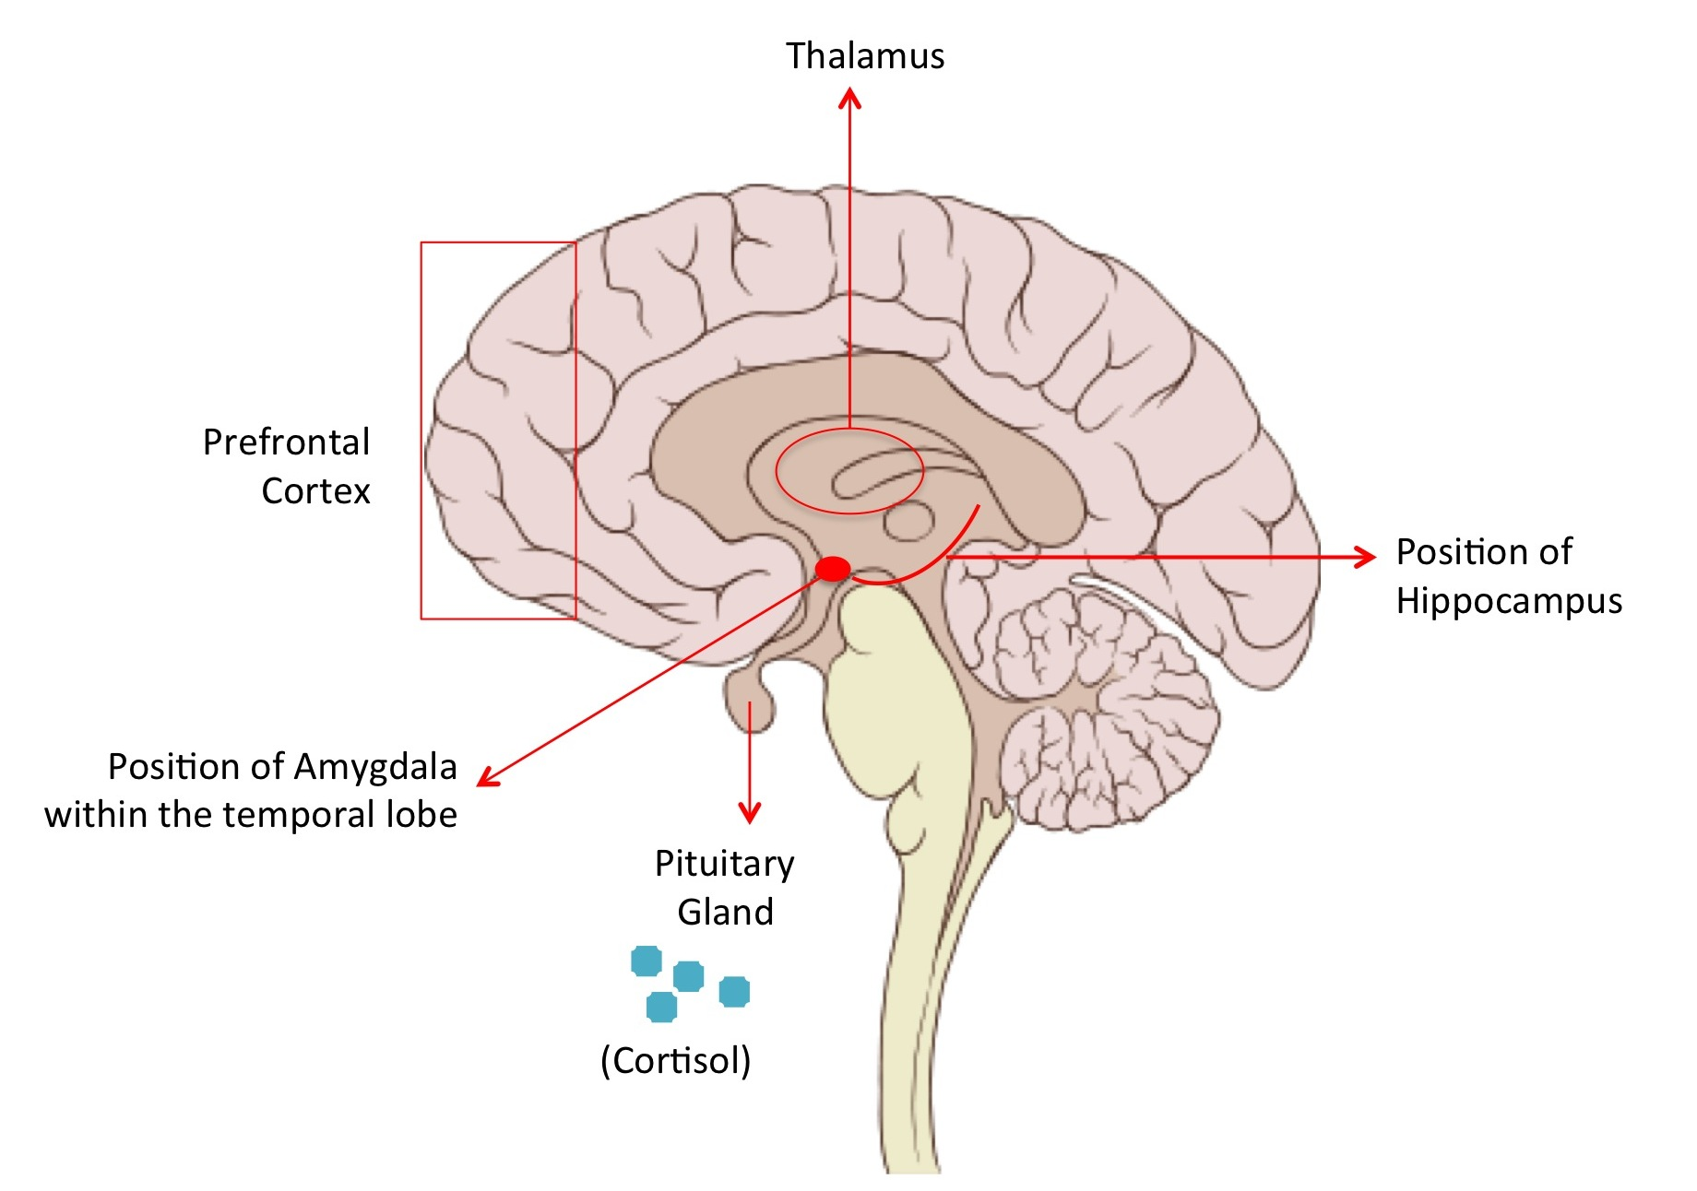
Neurobiology of Stress
Prefrontal Cortex
Executive functioning (problem solving, memory, impulse control)
Puts the “brakes” on the Amygdala
Position of the Hippocampus
Stores memory & learning
Triggers stress response for similar memories
Position of the Amygdala
Triggers emotional & stress responses
Notes:
Limbic brain includes the Hippocampus, Amygdala and the Hypothalamus
The key areas of the brain that are involved in stress are the thalamus, hippocampus, amygdala, and the prefrontal cortex. The thalamus located in the forebrain processes the incoming visual and auditory signals and relays them to the prefrontal cortex and the amygdala. The prefrontal cortex is the hub for executive function. With respect to stress, it gives meaning to the relayed signals and makes us conscious of what we see and hear. This part of the brain is also critical for ‘turning off’ the stress response once the condition is passed.
The amygdala is the emotional center of the brain and is responsible for triggering the stressful response. It is a part of the limbic system and is located deep within the temporal lobes of the brain.
The amygdala also drives the body’s sympathetic nervous system to initiate anxiety that is associated with stress. This includes increasing the heart rate, blood pressure, hyperventilation of the lungs and increasing perspiration.

Slide 30
The ACE Study Results
Source: CDC. https://www.cdc.gov/violenceprevention/acestudy/ace_graphics.html

Slide 31
Toxic Stress and its Impact on Neurodevelopment
Amygdala Dominant
Impaired memory
Poor concentration
Easily provoked
On edge
Unable to follow directions
Impulsive
Hard to sit still
Frontal Lobe Suppressed
Problem solving
Planning
Adaptation to change
Self-control
Self-confidence
Manage temper
Follow directions
Delay gratification
Persist with task
This child’s brain has adapted to the environment
Notes:
THIS IS NOT TO SAY THAT THESE BEHAVIORS ARE SYMPTOMS OR OR CAUSED BY TOXIC STRESS NECESSARILY, BUT THAT IS A POSSIBILITY.

Slide 32
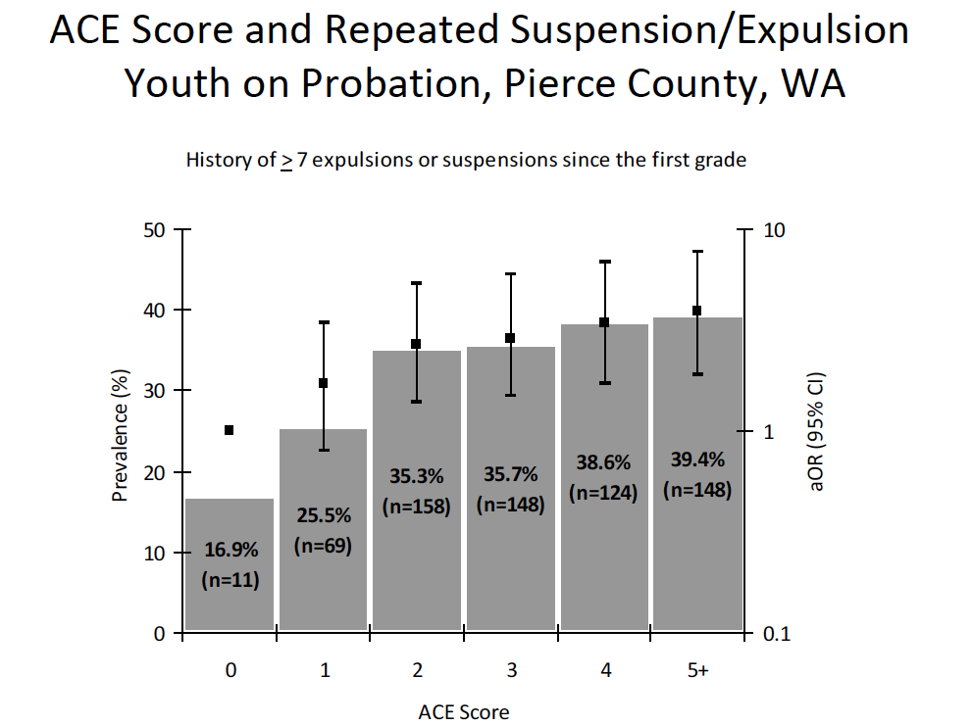

Slide 33
Source: www.slideshare.net

Slide 35
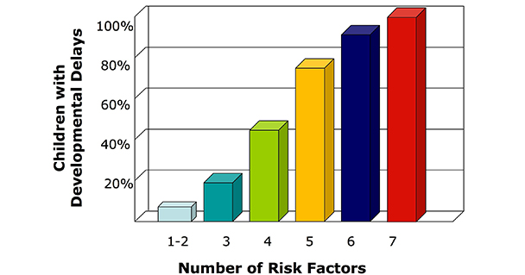
Significant Adversity Impairs Development in the First Three Years
Source: Barth et al (2008). Credit: Center on the Developing Child.
Notes:
Toxic stress impacts brain development.
This is how we see it play out in the patients we see…
…the more adversity a child faces early on in life, the higher their risk for developmental delays

Slide 36
Experiences become biology
Experience changes our genes, our brains and our health
Let’s reduce the # of ACEs a child experiences
Let’s change how a child experiences ACEs

Slide 37
ACE Score Predictive of future outcomes
Adverse Childhood Experiences (First 18 Years of Life)
Abuse
Emotional abuse
Physical abuse
Sexual abuse
Neglect
Emotional neglect
Physical neglect
Household Challenges
Mother treated violently
Household substance abuse
Mental illness in household
Parental separation or divorce
Criminal household member
Source: https://www.cdc.gov/violenceprevention/acestudy/about.html
Notes:
First 18 years of life

Slide 38
What happened to you?
Physical, sexual, emotional abuse or neglect
Chaotic or unpredictable parenting
Parents with mental illness or substance abuse
Home or community violence
Bullying, racism, poverty
Abandonment
Foster care
Intergenerational trauma

Slide 39
Impact on Learning
Washington State
13 out of every 30 students have 3 or more ACEs

Slide 40
Impact on Learning
Students with 3 or more ACEs:
Are 2 ½ times more likely to fail a grade
Have language difficulties
Score lower on standardized tests
Are designated to special education more frequently
Have poorer health
Are suspended or expelled more
Courtesy of Chris Blodgett, PhD Washington State University

Slide 42
Impact on Learning
Trauma may make it more difficult for children to:
Manage their emotions
Control physical & emotional responses (fights & disruptions)
Trust others
Form positive relationships
Learn & memorize
Moderate eating and sleep
Stay healthy
Notes:
Limbic brain includes the Hippocampus, Amygdala and the Hypothalamus

Slide 43
Source: Helping Foster and Adoptive Families Cope With Trauma: A Guide for Pediatricians

Slide 44
“It is easier to build strong children than to repair broken men.”
Frederick Douglass

Slide 45
RESILIENCE:
The Art of Bouncing Back
Notes:
There are many definitions of resilience. Resilience is positive, adaptive response in the face of significant adversity.
It helps us explain why some children do well in spite of significant adversity. It transforms potentially toxic stress into tolerable stress.
www.developingchild.Harvard.edu

Slide 46
How Resilience is Built

Slide 47
Fostering Resilience
What can we do?
Provide supportive adult-child relationships
Scaffold learning so the child builds a sense of self-efficacy and control
Promote adaptive skills and self-regulatory capacities
Source: “In Brief: The Science of Resilience” www.developingchild.harvard.edu
Notes:
Research has identified a set of factors that help children achieve positive outcomes in the face of significant adversity.
“One promising approach to strengthening adaptability is through the development of explicit skills and capabilities that support cognitive flexibility, goal-setting, problem-solving, and the ability to resist impulsive behavior.”
= Executive Functioning

Slide 48
Fostering Resilience
Notes:
Resilience is really this balance of risk factors and protective factors. In order to be resilient, you need to have more protective factors, such as supportive relationships, adaptive responses and positive experiences. So how can we support resilience?

Slide 49
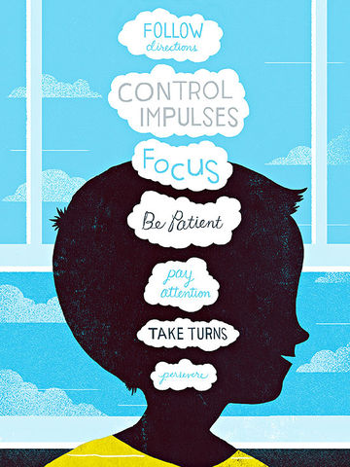
Executive Functioning

Slide 50
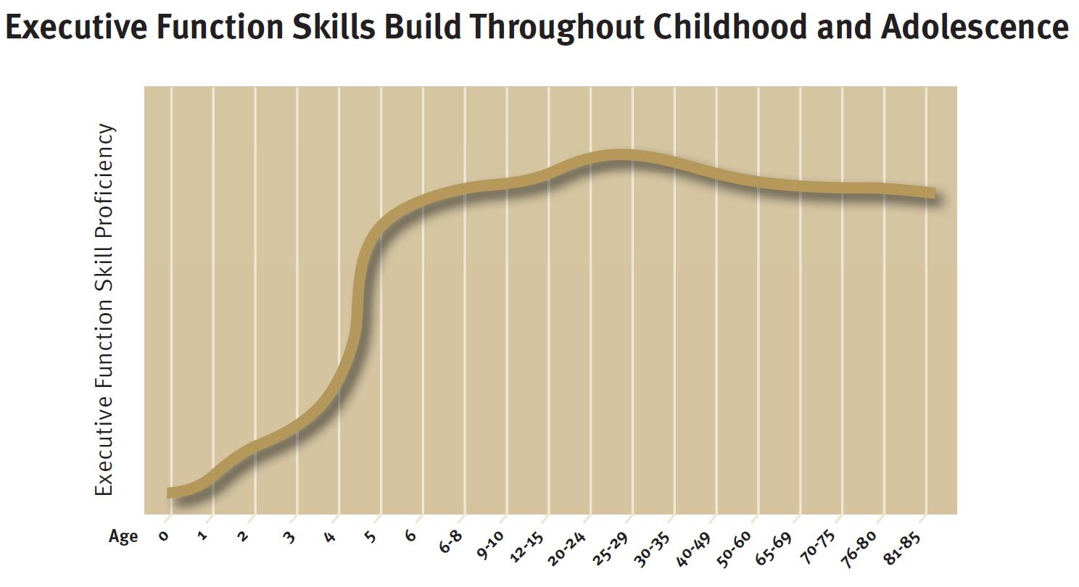
Executive Functioning
Source: Weintraub et al. Credit: Center on the Developing Child

Slide 51
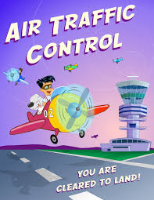
Executive Functioning
Allows us to focus, hold, and work with information, filter distractions and switch gears
We are born with the potential to develop these skills
National Scientific Council on the Developing Child. (2011). Building the Brain’s “Air Traffic Control” System: How Early Experiences Shape the Development of Executive Function: Working Paper 11. http//www.developingchild.Harvard.edu
Notes:
We are born with the potential to develop these skills…or not…depending on childhood experiences

Slide 52
Executive Functioning
Executive functioning is made up of three dimensions which work together:
Working memory
The capacity to hold and manipulate information in our heads over a short period of time
Inhibitory Control
The ability to master and filter our thoughts and impulses
Cognitive or Mental Flexibility
The capacity to switch gears and adjust
National Scientific Council on the Developing Child. (2011). Building the Brain’s “Air Traffic Control” System: How Early Experiences Shape the Development of Executive Function: Working Paper 11. http//www.developingchild.Harvard.edu

Slide 53
The Biology of Executive Functioning
The areas of the brain primarily involved in executive functioning include the prefrontal cortex, anterior cingulate, parietal cortex and hippocampus
These areas have extensive interconnections with deeper brain structures involved in responses to threat and stress
Formative development occurs during early childhood and is refined during adolescence and into early adult years
National Scientific Council on the Developing Child. (2011). Building the Brain’s “Air Traffic Control” System: How Early Experiences Shape the Development of Executive Function: Working Paper 11. http//www.developingchild.Harvard.edu
Notes:
The developing executive functioning system both influences and is affected by the young child’s experience and management of threat, stress and strong emotions.

Slide 54
Building Executive Functioning Skills
The critical factors in developing strong executive functioning skills are children’s relationships, the activities they have the opportunity to engage in, and the places in which they live, learn and play.
Source: “In Brief: Executive Function: Skills for Life and Learning” www.developingchild.harvard.edu

Slide 55
Building Executive Functioning Skills
In relationships, children need adults to:
Support their efforts
Model skills
Engage in activities in which they practice the skills
Provide a consistent, reliable presence
Guide them from complete dependence on adults to gradual independence
Protect them from chaos, violence and chronic adversity
Source: “In Brief: Executive Function: Skills for Life and Learning” www.developingchild.harvard.edu

Slide 56
Building Executive Functioning Skills
Communities and caregivers must provide activities that:
Reduce stress
Foster social connection and open-ended creative play
Incorporate vigorous physical exercise
Increase the complexity of skills step-by-step
Include repeated practice
Source: “In Brief: Executive Function: Skills for Life and Learning” www.developingchild.harvard.edu

Slide 57
Building Executive Functioning Skills
The places where children spend most of their time must:
Feel (and be) safe
Provide space for creativity, exploration and exercise
Be economically and socially stable
Source: “In Brief: Executive Function: Skills for Life and Learning” www.developingchild.harvard.edu

Slide 58
Impact of Strengthening Executive Functioning Skills
The long-term results of building executive functioning skills include improvements in:
School achievement
Positive behaviors
Good health
Successful work
Executive function capacities can be enhanced throughout development; however, its easier, less costly and more effective to build these skills from the start
Source: “In Brief: Executive Function: Skills for Life and Learning” www.developingchild.harvard.edu

Slide 59
Maya Angelou
“I’ve learned that people will forget what you said, people will forget what you did, but people will never forget how you made them feel.”

Slide 60
View children & adult behavior through a “Trauma Lens”
ask: What happened to you?
rather than: What’s wrong with you?

Slide 61
Responding to Trauma “PEARLS”
P – Partnership | Let’s work together
E – Empathy | That sounds frustrating
A – Apology | I am sorry that happened
R – Respect | You have gone through a lot
L – Legitimization | I understand why you’re upset
S – Support | Let’s see what we can do

Slide 63
Building Resilience as an Adult
Practice optimism
Rewrite your story
Don’t personalize it
Remember your comebacks
Support others
Take stress breaks
Go out of your comfort zone
Resilience: The Science of Mastering Life’s Greatest Challenges. Dennis Charney
Notes:
2) Study after study has shown that we can benefit from reframing the personal narrative that shapes our view of the world and ourselves. In expressive writing studies, college students taught to reframe their college struggles as a growth opportunity got better grades and were less likely to drop out. A Harvard study found that people who viewed stress as a way to fuel better performance did better on tests and managed their stress better physiologically than those taught to ignore stress. “It’s about learning to recognize the explanatory story you tend to use in your life,” Dr. Southwick said. “Observe what you are saying to yourself and question it.
4) “Look back and say, ‘I’ve gone through something worse in the past. This is not the most horrible thing I have ever faced or will ever face. I know I can deal with it.’”
5) Resilience studies show that people are more resilient when they have strong support networks of friends and family to help them cope with a crisis. But you can get an even bigger resilience boost by giving support

Slide 64
Source: https://www.cdc.gov/violenceprevention/acestudy/ace_graphics.html
Notes:
ACEs are dose dependent

Slide 65
Source: https://www.cdc.gov/violenceprevention/acestudy/ace_graphics.html
Notes:
ACEs are dose dependent

Slide 67
Resilience
Resilience can be strengthened at any age
Resilience can be situation-specific
It is the interaction between biology and environment which builds the capacity to cope with adversity:
Strong relationships with caring adults
Intrinsic resistance to adversity
National Scientific Council on the Developing Child. (2015). Supportive Relationships and Active Skill-Building Strengthen the
Foundations of Resilience: Working Paper 13. http//www.developingchild.Harvard.edu
Notes:
There are many definitions of resilience. Resilience is positive, adaptive response in the face of significant adversity.
It helps us explain why some children do well in spite of significant adversity. It transforms potentially toxic stress into tolerable stress.
It is a dynamic interaction between internal predispositions and external experiences
www.developingchild.Harvard.edu

Slide 68
The Biology of Resilience
Resilience is seen in how the body responds to experiences during development through:
Gene expression
Brain function
Immune-related responses
National Scientific Council on the Developing Child. (2015). Supportive Relationships and Active Skill-Building Strengthen the
Foundations of Resilience: Working Paper 13. http//www.developingchild.Harvard.edu
Notes:
GENE EXPRESSION:
ex. Certain genetic variants result in the production of proteins in the brain that control the chronic stress response, either exaggerating or blunting it
Biological differences also control the sensitivity of genes to environmental influences
Certain genetic variations have also been shown to enhance the beneficial effects of a protective intervention
BRAIN FUNCTION:
Ex. Variation in the activation of brain chemical, such as oxytocin and vasopressin, is related to the ability to initiate and sustain social behavior, form attachments with other and manage social anxiety
Functional difference in the brain’s fear and reward circuits may also be responsible for capacity-building traits like optimism and emotion regulation
IMMUNE-RELATED RESPONSES:
Ex. The body’s ability to restore balance between pro- and anti-inflammatory cytokines after a stress-inducing experience can be a biological marker of resilience

Slide 69
Neurobiology of Stress
Prefrontal Cortex
Executive functioning (problem solving, memory, impulse control)
Puts the “brakes” on the Amygdala
Position of the Hippocampus
Stores memory & learning
Triggers stress response for similar memories
Position of the Amygdala
Triggers emotional & stress responses
Notes:
Limbic brain includes the Hippocampus, Amygdala and the Hypothalamus
The key areas of the brain that are involved in stress are the thalamus, hippocampus, amygdala, and the prefrontal cortex. The thalamus located in the forebrain processes the incoming visual and auditory signals and relays them to the prefrontal cortex and the amygdala. The prefrontal cortex is the hub for executive function. With respect to stress, it gives meaning to the relayed signals and makes us conscious of what we see and hear. This part of the brain is also critical for ‘turning off’ the stress response once the condition is passed.
The amygdala is the emotional center of the brain and is responsible for triggering the stressful response. It is a part of the limbic system and is located deep within the temporal lobes of the brain.
The amygdala also drives the body’s sympathetic nervous system to initiate anxiety that is associated with stress. This includes increasing the heart rate, blood pressure, hyperventilation of the lungs and increasing perspiration.

Slide 70
Taking Action

Slide 71
Questions
What are you doing currently to address ACES/adversity and promote resilience?
What barriers do you foresee or have you experienced in collecting this information?
Would you collect this information?
If so, how would you implement collecting this data?
What outcomes would you follow?

Slide 73
Positive Behavioral Interventions and Supports (PBIS), Safe and Civil Schools, Restorative Justice
Trauma-Informed Care Components Creating safe environments, opportunities for students to address trauma symptoms and regulate emotions related to trauma experiences
Age appropriate trauma-informed care interventions within the schools
Training for ALL school staff – administrators, teachers, school-based health center staff, psychologists, counselors, janitors, bus drivers, coaches, etc.
Tiered approach to implementation
Tier 1: universal support Tier 2: supplemental support Tier 3: intensive support
High self-care for frontline staff (teachers, psychologists, etc.) – develop system that helps them identify and address their own traumas and ability to help students
Data collection – staff feasibility / acceptability with trauma-informed components, student utilization of safe spaces that are created, prevalence of trauma and types of trauma
Additional partnerships (or optimization of current ones) with community resources

Slide 74
TIER 3 Intensive Support
TIER 2 Supplemental Support
TIER 1 Universal Support
Tiered Trauma-Informed Care Support and Services

Slide 75
Create 10 minute “calm zones” for students
sensory experiences to calm down
deep breathing, stress balls, playdoh, social emotional regulation, bubbles, relaxing music, etc.
Provide trauma training for all staff
intensive training for teachers and administrators
Develop school policies that address trauma
Implement student social-emotional regulation exercises
such as emotional bingo
Increase positive recognition programs
award good behaviors/outcomes
Encourage school culture change
meditation, restorative justice classroom circles, increased physical activity, school gardens
TIER 1 Universal Support

Slide 76
TIER 2 & 3 Supports
Trauma screening
Consultation teams to discuss student progress related to trauma
Trauma-focused 504 plans
Group interventions with peers experiencing similar trauma
Parent engagement, behavior contracts
CBITS / SSET training for teachers, administrators and mental health professionals
Individual interventions
Wrap-around services
Increased parent engagement (CARE, PCIT)
Community referral(s)
TIER 2 Supplemental Support
TIER 3 Intensive Support

Slide 77
Child-Adult Relationship Enhancement (CARE™)
A trauma-informed and generalizable set of skills
based on 45 years of evidence-based parenting programs
Not a therapy but skills for adults interacting with children or teens to:
improve the relationship
increase the likelihood of compliance
reduce behavior problems
Can complement other treatment programs including
mental health services
childcare and school settings

Slide 78
CARE™ outcomes have been positive for children & families with adverse experiences
Pediatric primary care setting
decreased reliance on harsh parenting
increased parental empathy towards the child
improved child behaviors
Foster care setting
increased positive parenting skills
decreased foster child behavioral problems & anxiety symptoms

Slide 79
CARE™ training has been implemented
Doctors, Nurses, Mental health providers, Speech pathologists, Physical & Occupational therapists
Parents, Foster parents
Child protection workers, Caseworkers, Child Victim Advocates, Staff at domestic violence & homeless shelters
School personnel (teachers, administrators, support staff, nurses, cafeteria workers, bus drivers, security officers)
Child care providers, Home visitors
Camp counselors, Clergy
Military families coping with deployment stressors
Office staff

Slide 80
CARE™ training is available
Training is interactive!
Skills are taught and practiced
Tailored for specific group/agency needs
3-6 hours
For information on attending a CARE training
Debbie.sharp@cchmc.org
Erica.Messer@cchmc.org

Slide 82
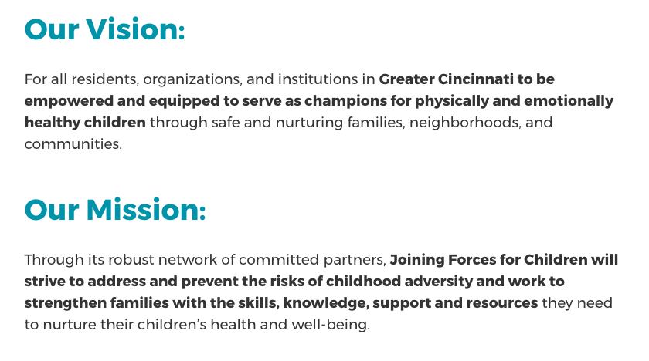
https://joiningforcesforchildren.org/

Slide 83
Notes:
What can you do to reduce the impact of ACEs? (single word responses only) https://www.polleverywhere.com/free_text_polls/1WScy6D9vffrm0w

Slide 84
Thank you!
Joining Forces for Children
https://joiningforcesforchildren.org/
Center on the Developing Child at Harvard University
https://developingchild.harvard.edu/
Centers for Disease Control and Prevention
https://www.cdc.gov/violenceprevention/acestudy
TED Talk by Dr. Nadine Burke Harris:
How childhood trauma affects health across a lifetime
https://www.ted.com/talks/nadine_burke_harris_how_childhood_trauma_affects_health_across_a_lifetime

